Slide 1
Stabilisering Enhet
Amir K, Maiar S, Raj S, Sami K

Slide 2
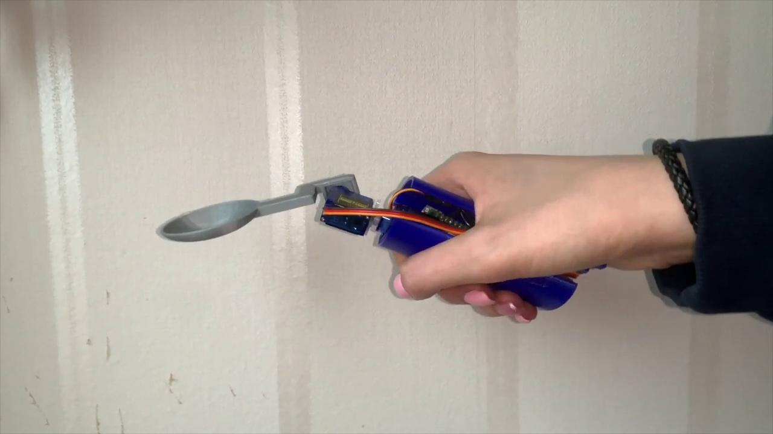

Slide 3

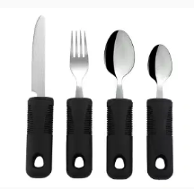
Why this is a problem and alternative solutions

Slide 4
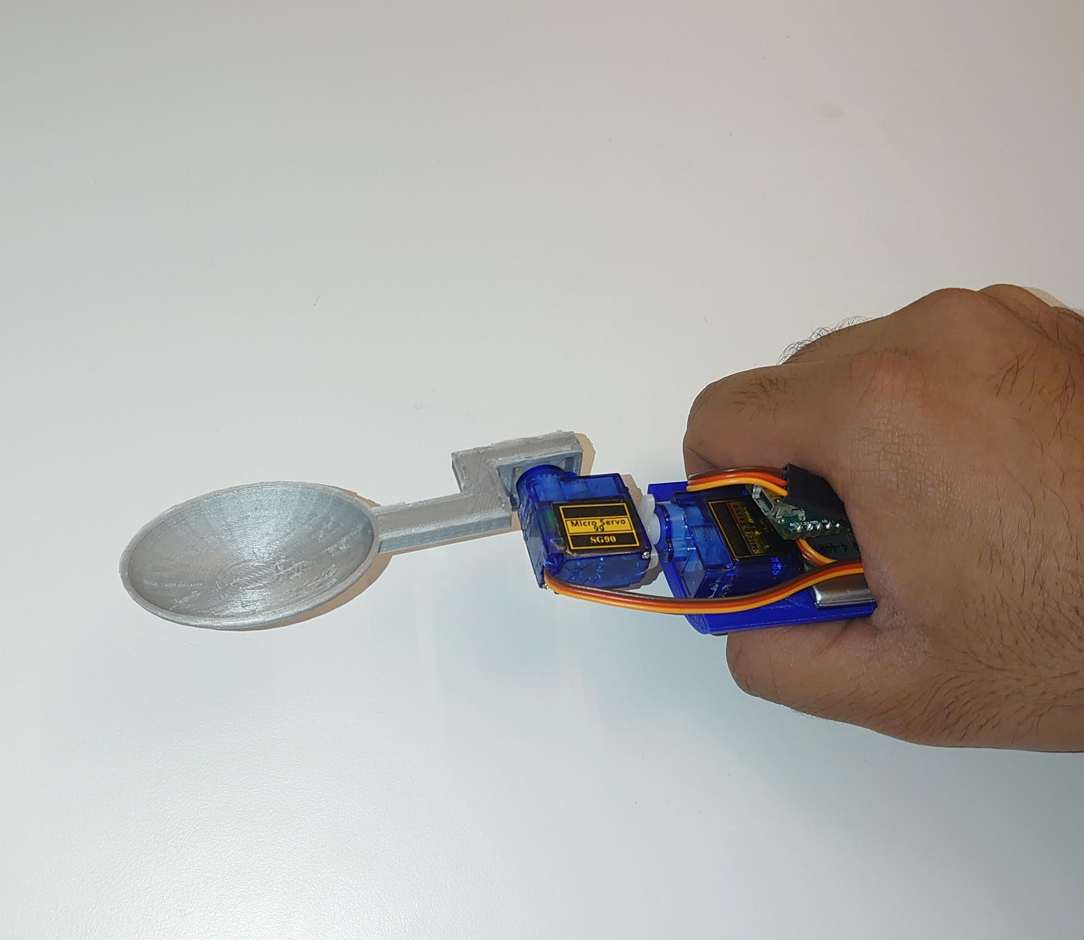
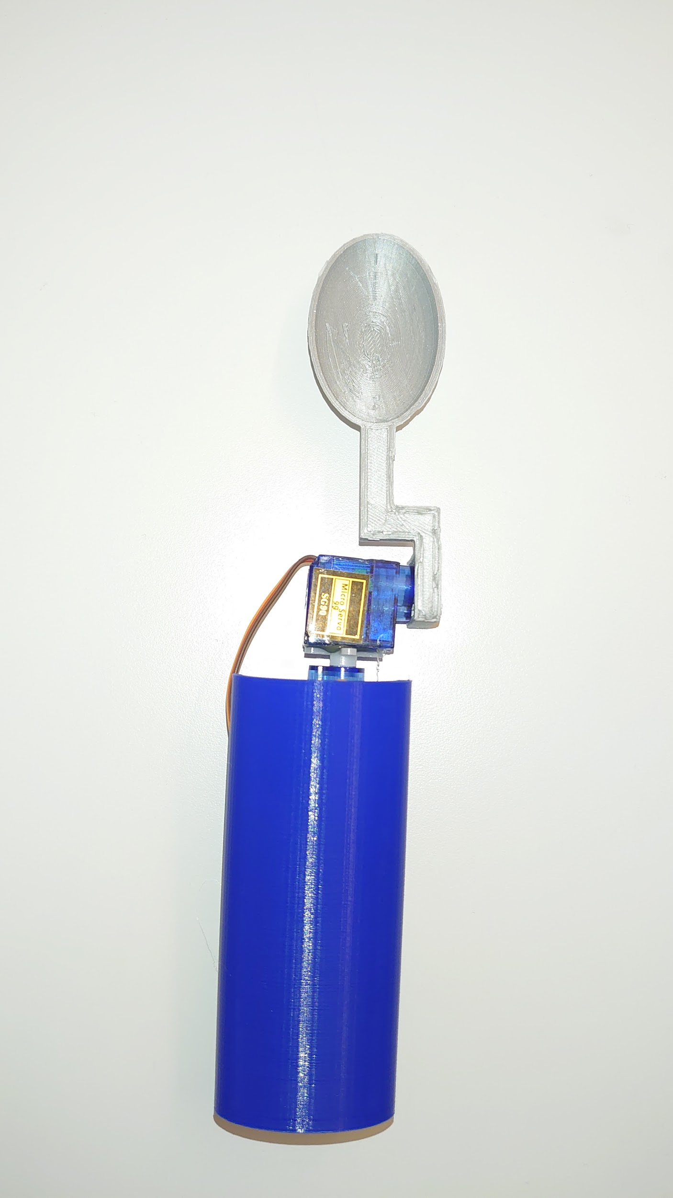
Our solution

Slide 5
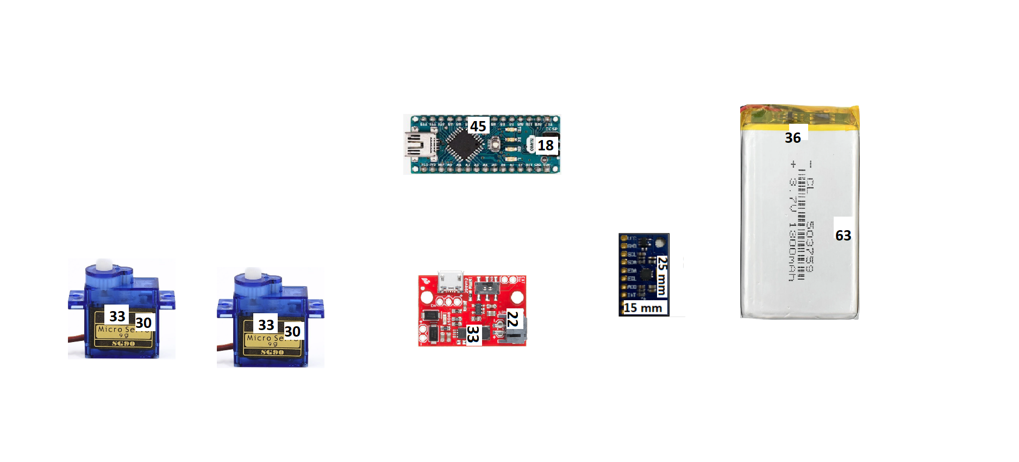

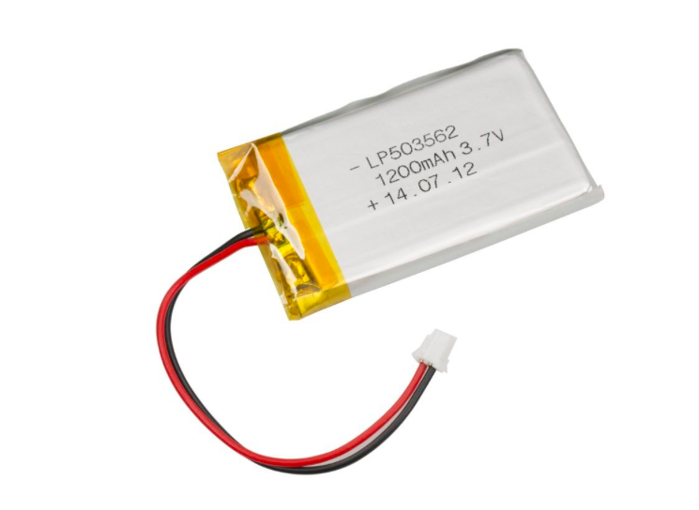
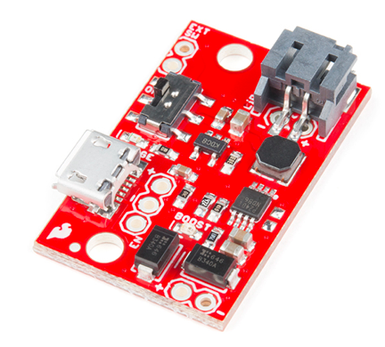
Technical part
Simplicity of the design
Battery

Slide 6
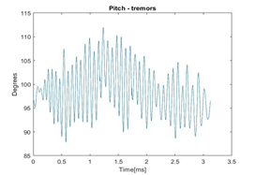
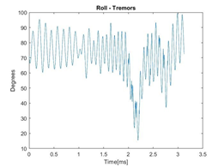
Result

Slide 7
Future work
We could have used an Arduino chip with built in accelerometer instead of using a different component for that.
Battery
Design
Servo motors

